Slide 1
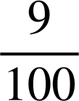
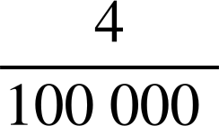


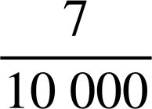
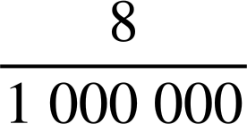
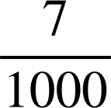
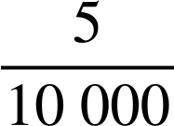

Multiples of 10 involving negative exponents
Task A: Introducing negative exponents
Fill in the gaps:
 | Decimal | Fraction | Exponential Form
a | 0.09 |  | 9 × 10⁻²
b | 0.00004 |  | 4 × 10⁻⁵
c | 0.3 |  | 3 × 10⁻¹
d | 0.2 |  | 2 × 10⁻¹
e | 0.0007 |  | 7 × 10⁻⁴
f | 0.000008 |  | 8 × 10⁻⁶
g | 0.007 |  | 7 × 10⁻³
h | 0.0005 |  | 5 × 10⁻⁴
2) What mistake has Aisha made?
Write 0.0003 in expanded exponential form.
Aisha writes:
0.0003 = 3 × 10⁻³ because there are 3 zeros after the decimal point.
The 3 is in the ten thousandths column.
10⁻³ is one thousandth not one ten thousandth.
Therefore, the answer should be 3 × 10⁻⁴
Aisha
3) Write each of the following in the alternative format:
 | Decimal | Exponential form
a | 0.34 | 3 × 10⁻¹ + 4 × 10⁻²
b | 0.52 | 5 × 10⁻¹ + 2 × 10⁻²
c | 0.0473 | 4 × 10⁻² + 7 × 10⁻³ + 3 × 10⁻⁴
d | 0.049 | 4 × 10⁻² + 9 × 10⁻³
e | 0.000603 | 6 × 10⁻⁴ + 3 × 10⁻⁶
f | 0.200303 | 2 × 10⁻¹ + 3 × 10⁻⁴ + 3 × 10⁻⁶
g | 17.02 | 1 × 10¹ + 7 × 10⁰ + 2 × 10⁻²
h | 200.3058 | 2 × 10² + 3 × 10⁻¹ + 5 × 10⁻³ + 8 × 10⁻⁴

Slide 2

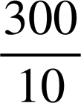
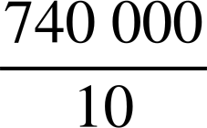
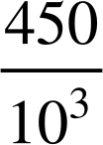
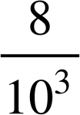
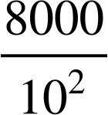
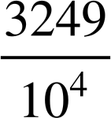
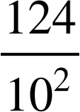
Multiples of 10 involving negative exponents
Task B: Writing integers in a range of forms
Identify the incorrect alternative in each row. Record the letter and rearrange them to make a word. EXPONENT
Number | Alternative 1 | Alternative 2 | Alternative 3 | Alternative 4
3000 | 3 × 10⁴ | 3 × 10² × 10 | × 10³ | × 10²
74 000 | 7.4 × 10⁴ | 74 × 10³ | 7.4 × 10³
120 000 | 12 × 10² × 10² | 1.2 × 10⁵ | 1.2 × 10⁴ | 1.2 × 10⁶ × 10⁻¹
450 | 4500 × 0.1 | × 10³ | 4.5 × 10² | 4.5 × 10⁻²
8 000 000 | 8 × 10³ × 10³ | × 10⁸ | 8 × 10⁶ | × 10⁵
628 000 | 6 280 000 × 10⁻¹ | 6.28 × 10⁵ | 6.28 × 10³ | 628 × 10³
32 490 | 32.49 × 10² | 324.9 × 10² | × 10⁵ | 324 900 × 10⁻¹
12 400 000 | 12.4 × 10⁻³ × 10⁹ | × 10⁷ | 1.24 × 10⁷ | 124 × 10⁻² × 10⁶
N
L
I
Y
A
P
X
C
R
H
E
B
S
E
F
O
T
P
V
D
O
D
N
P
E
M
A
H
N
L
O
T
Mathematics in Education and Industry
v2.3

